Slide 1
W04D1 – Dimensionality Reduction
Instructor: Jeremy Eng
Credit: Socorro Dominguez and Eric Elmoznino

Slide 2

Introduction
Instructor: Dr. Jeremy Eng (engj@saskpolytech.ca)
Lead Cloud Applications and Data Instructor at Sask Polytech
Born and raised in Saskatoon, Saskatchewan
PhD in Statistics
Research Areas:
Big data simulations involving Monte Carlo techniques
Developing and applying machine learning techniques to model COVID-19 spread in Saskatchewan and Canada (PMCMC)
Microsoft Certified Trainer
LinkedIn: https://www.linkedin.com/in/jeremy-eng-sk/

Slide 3
Outline
Intro to dimensionality reduction
Motivation
Two classes: dimensionality reduction and variable selection
Dimensionality reduction techniques
Principal Component Analysis (PCA)
Linear Discriminant Analysis (LDA)
Variable selection techniques
Filter Methods
Wrapper Methods
PCA demo

Slide 4
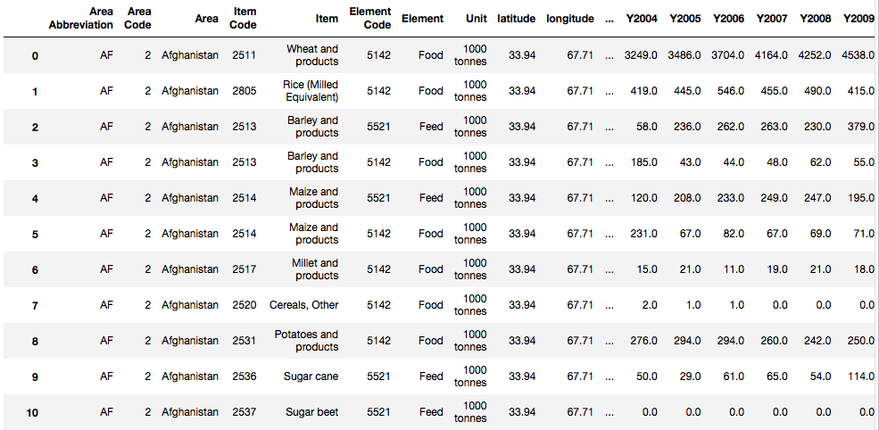
Motivation
High dimensionality = large number of features/variables
Structured (tabular) data
Usually rows=observations, columns=features/variables
Unstructured data
Images, video, audio
Ex: Dataset of name, age, gender, ethnicity, height, weight, location, income, etc. (many columns→high dimensionality).
Ex: Dataset of images (each image=row, each pixel RGB value = column.
Notes:
Dimension = number of features/variables

Slide 5
Motivation
Why is high dimensional data a problem? Isn’t more data better?
Observations vs dimensions
Dimensionality reduction (reducing the number of features) can result in:
Visualizations (2-3 dimensional plots)
Lower computational complexity (time and space)
Improve model performance (e.g. accuracy)
Avoid over-fitting
How can we reduce the number of features?
Dimensionality reduction (transform features into a lower dimension using linear algebra)
PCA
LDA
Variable selection (simply selecting or excluding certain variables)
Filter methods
Wrapper methods

Slide 6
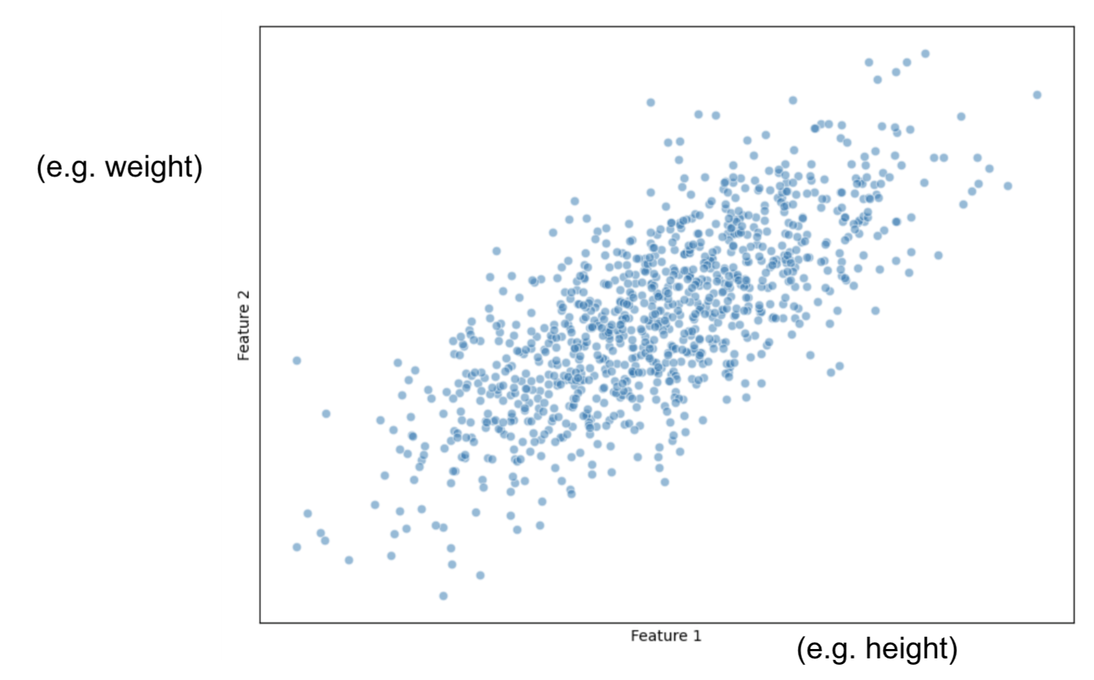
PCA
Principal Component Analysis
Most popular (and important)
Idea: represent many variables with fewer variables while minimizing loss of information
Simplest case: represent two variables as a single variable
How would you do this?
height (h) | weight (w)
170 | 80
175 | 81
161 | 71
182 | 83
164 | 76
165 | 76
185 | 90
???
Notes:
Just ignore one of the variables
Add them? Multiply?
-Use a “linear combination” of the two variables ah+bw=s (creates a line)
-This is called a “linear transformation”
-Relate back to linear algebra: [X][a;b] = [Z]

Slide 7
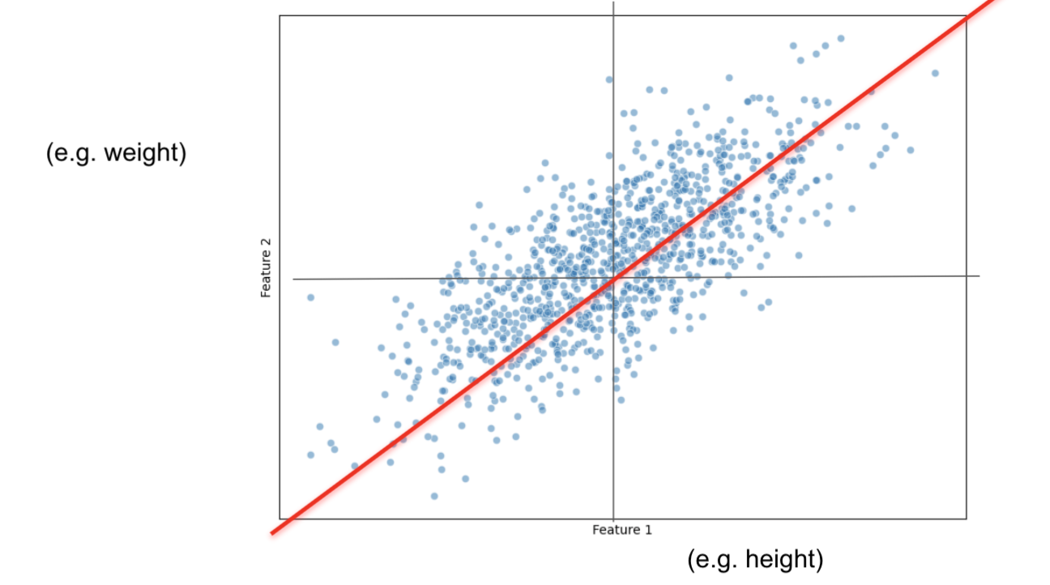
PCA: Linear Combinations
We can use a linear combination of our two variables to transform our two variables into a single variable (size).
ah + bw = s (line)
Can think of it as a “projection”
How do we choose a and b?
Graphically, we want to create a “best-fit” line that passes through the mean of each variable.
By “best-fit”, we mean the perpendicular distance from the points to the line is minimized.
Can also think of this line as going in the direction of MOST variation.
This line we found is referred to as Principal Component 1 (PC1).
Notes:
Talk about projection onto just height or just weight. Then talk about projection onto line.

Slide 8
PCA: Principal Components
What if we have d variables and want to reduce down to k variables?
Turns out, we just need to find the first k principal components!
Let’s discuss principal components more!
For each dimension (variable/feature) in our data, we also have that many principal components.
E.g. if we have two variables, there are two principal components (we just found the first one in the last example).
E.g. if we have 100 variables, there are 100 principal components.
We showed how to find PC1, but how do we find PC2, PC3, etc.?
Remember that PC1 was a “best-fit” line in the direction of MOST variation.
PC2 will be in the direction of the next most variation, following a few rules:
Must pass through the mean of each variable
Must be perpendicular/orthogonal to all other previous principal components.
Following these rules, PC2, PC3, …, PCk can be found in order!
This way, we are keeping the principal components that have the most variation!
Notes:
Orthogonality forces the next PC in the direction of the “next most” variation.

Slide 9
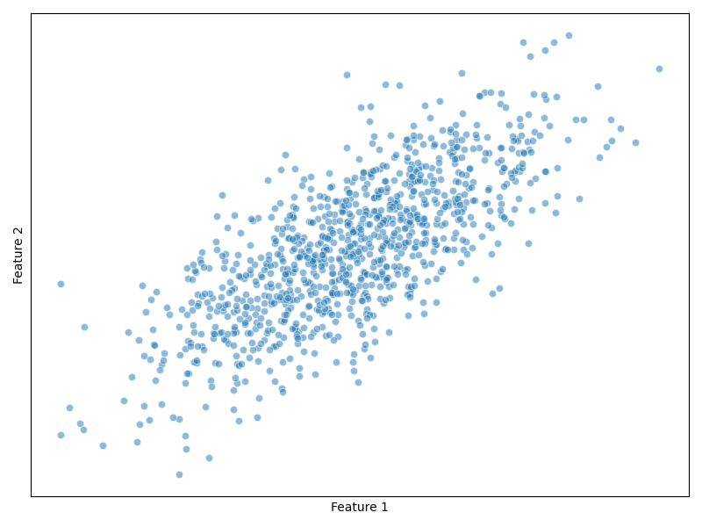
PCA: Change of basis
Another way to think of PCA is performing a change of basis

Slide 10
PCA: Change of basis
Another way to think of PCA is performing a change of basis

Slide 11
PCA: Change of basis
Another way to think of PCA is performing a change of basis

Slide 12
PCA: Change of basis
Another way to think of PCA is performing a change of basis
PC 2
PC 1

Slide 13
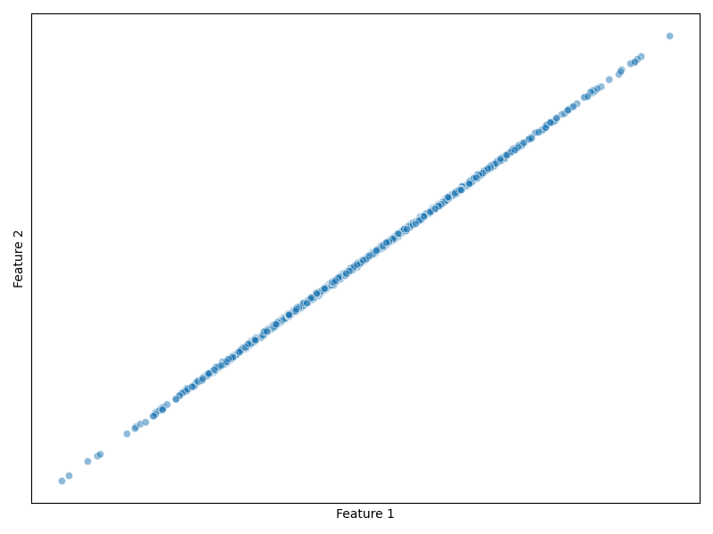
PCA: Extreme Cases
Extreme case where PCA is very useful (very little information lost)
PC 1
PC 2

Slide 14
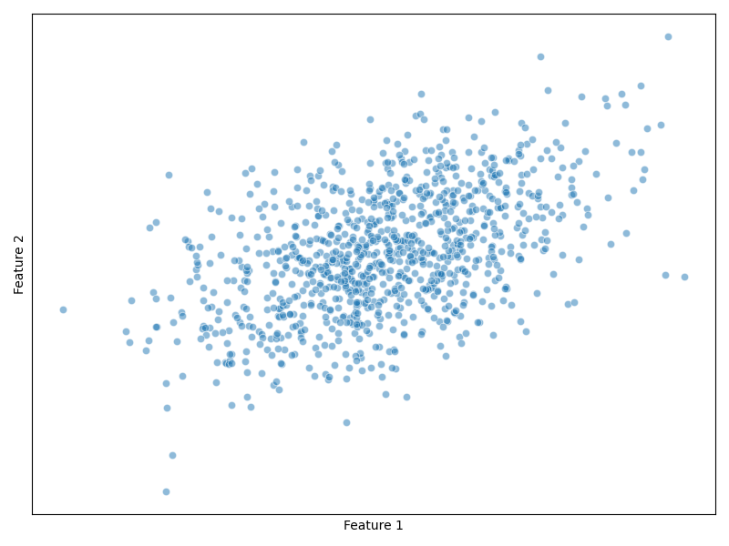
PCA: Extreme Cases
Other extreme case where PCA is NOT very useful (PC2 explains as much variance as PC1)
PC 2
PC 1

Slide 15
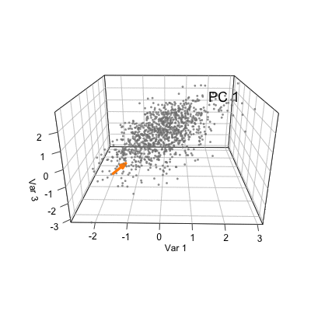
PCA: Visualized in 3 Dimensions
Source

Slide 16
PCA: The Math (yay!)
Suppose we have n observations, d original dimensions (variables/features), and we want to reduce down to k dimensions.
Original data: X_{(nxd)}
Reduced data: Z_{(nxk)}
Then: Z_{(nxk)} = X_{(nxd)}A_{(dxk)}
Where: The columns of A_{(dxk)} are the eigenvectors corresponding to k largest eigenvalues from the covariance matrix of X (C = X^{T}X/(n-1) for zero-mean data).
For details on the math behind PCA, see here.
Luckily we have Python’s sklearn library to do these calculations for us ☺

Slide 17
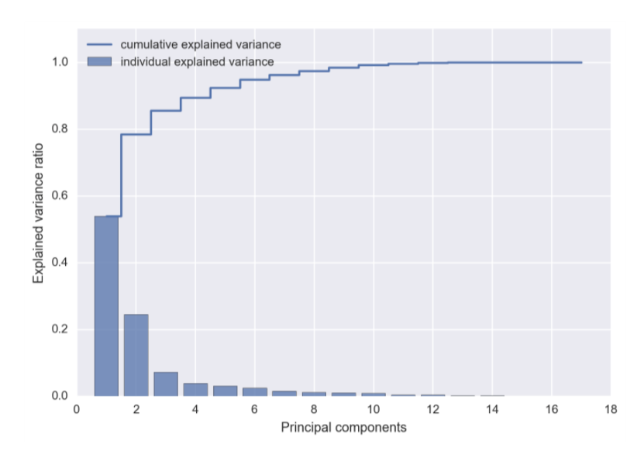
PCA: Choosing the New Dimension
We can use a Scree Plot to choose an optimal new dimension (i.e. number of principal components to keep).
A Scree Plot shows how much variance is explained by each PC.
Strategy: Keep number of PCs up to a certain % of total variance explained.
Strategy: Elbow method

Slide 18
PCA: Summary
We start with data consisting of n observations and d dimensions (X_{nxd})
Want to reduce down to n observations and k (< d) dimensions (Z_{nxk})
PCA creates principal components (PCs)
d vectors that represent:
A series of orthogonal “best-fit” vectors
A series of orthogonal vectors that point in the direction of most variance
When data is projected onto a PC, it gives one number.
Keep first k PCs
Done mathematically through matrix multiplication (python: sklearn)
Eigenvalues of covariance matrix: importance of PC
Eigenvectors of covariance matrix: direction of PC
Important to scale data prior to PCA (since it’s based on variance)
StandardScaler

Slide 19
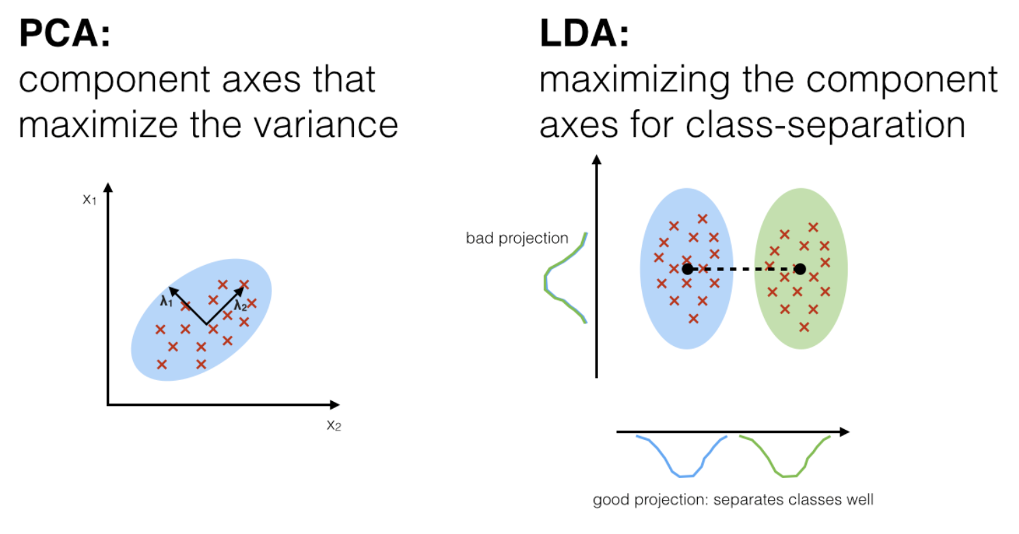
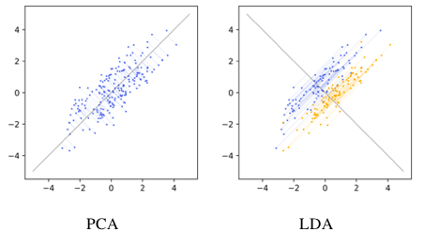
LDA
Linear Discriminant Analysis
Difference: uses the class label when choosing “PCs” (PC equivalents)
LDA is supervised, PCA is unsupervised
LDA aims to:
Minimize “intra-class” variance
Maximize “inter-class” variance
LDA can only be done for classification
Target variable is categorical
Notes:
Intra-class = within-class
Inter-class = between-class

Slide 20
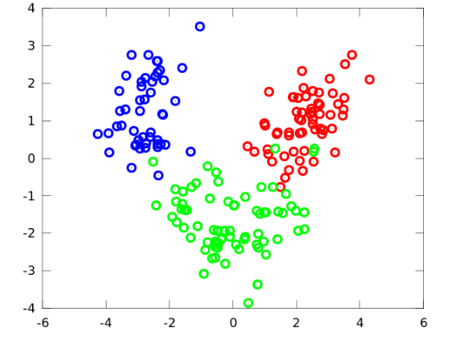
LDA: Multi-Class Example
Two dimensions, three classes.
Notes:
Consider x vs y dimension
Can we find two better dimensions?
-Trade off between getting all three correct vs perhaps you only are interested in a certain colour (one vs all).

Slide 21
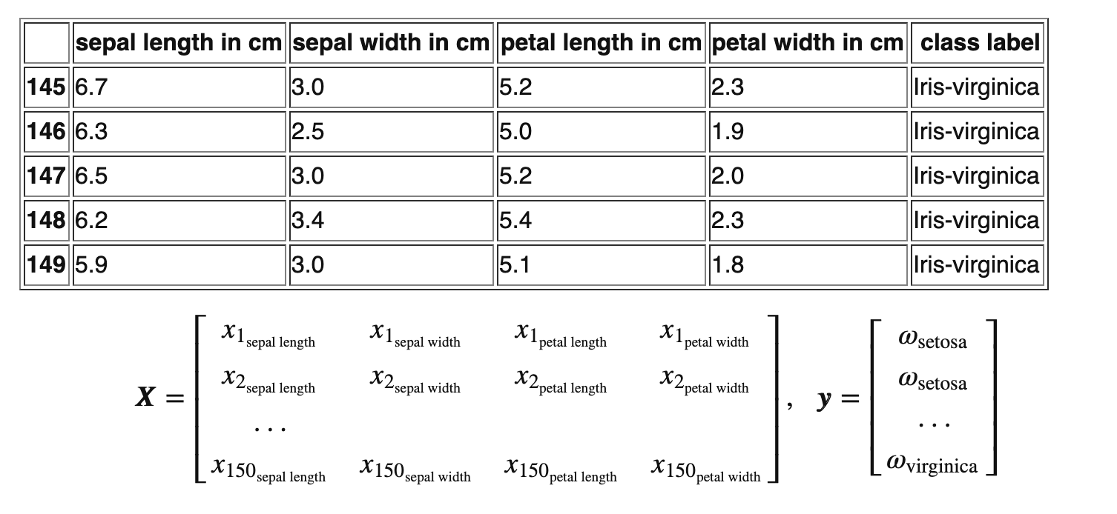
LDA: Iris example
Famous Iris dataset from sklearn.datasets by Sir R.A. Fisher
3 classes (target variable)
Setosa
Versicolour
Virginica
4 attributes
Sepal length
Sepal width
Petal length
Petal width
What is the original dimension?
Can we use PCA, LDA, or both?
Why?
Notes:
Original dimension = 4 (4 features)
Both because we have numerical data and target variable is categorical
Can’t visualize 4D data. Let’s use dimension reduction (LDA) to get it down to 2-dimensions

Slide 22
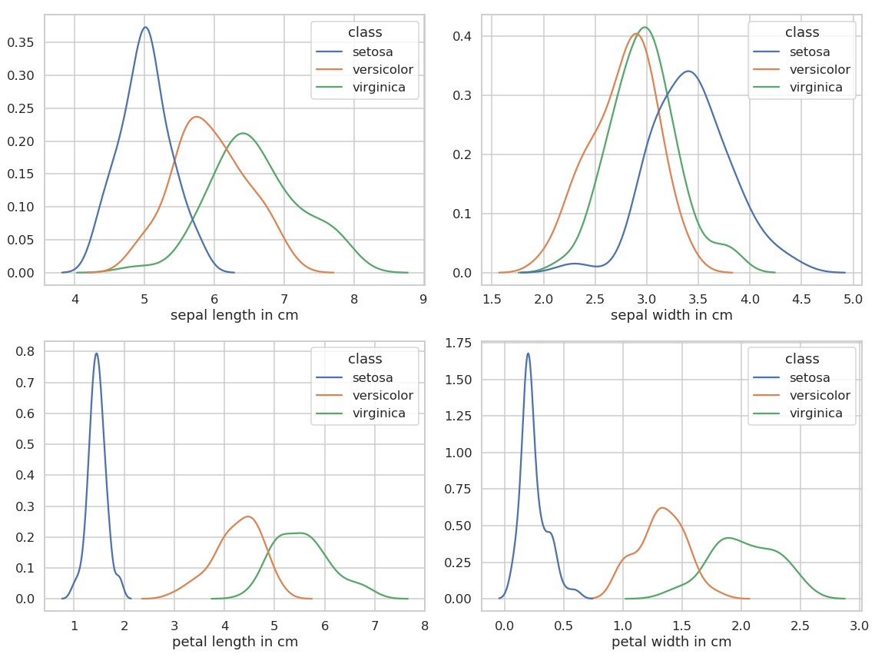
LDA: Iris example
Visualize each of the original 4 dimensions
If you had to choose 2 of these dimensions which would you choose?
Some dimensions are better than others
LDA will create “components” that best separate the classes.
Minimize “intra-class” variance
Maximize “inter-class” variance
Notes:
Intra-class = within-class
Inter-class = between-class

Slide 23
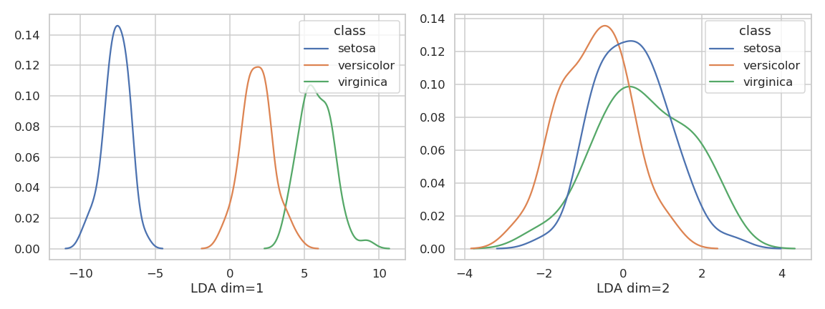
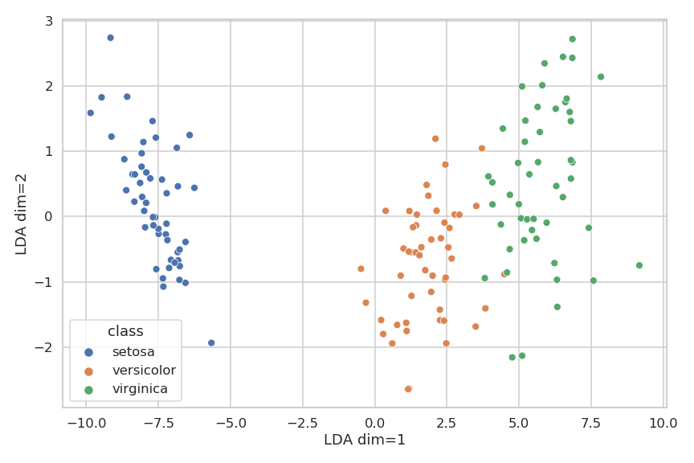
LDA: LDA on the Iris example
These are the results after using LDA to reduce the dimension down to two.
Since we are down to dim=2, we can now visualize.
How would we use these LDA dimensions to classify Iris type?
In practice, how many dimensions do you think we need?
Notes:
Use thresholds on dimension 1 to classify iris type
Probably only need one dimension (2nd dimensions doesn’t really help with classification of iris type)

Slide 24
PCA vs LDA
Both are dimensionality reduction techniques.
Both create new dimensions by using linear combinations of original dimensions
Create new basis in a way that minimizes “lost information”
PCA is most popular
PCA is unsupervised, LDA is supervised
LDA further requires target variable to be categorical
PCA creates successive PCs in directions of MOST variance
LDA creates successive components that
Minimize “intra-class” variance
Maximize “inter-class” variance
Notes:
Intra-class = within-class
Inter-class = between-class

Slide 25
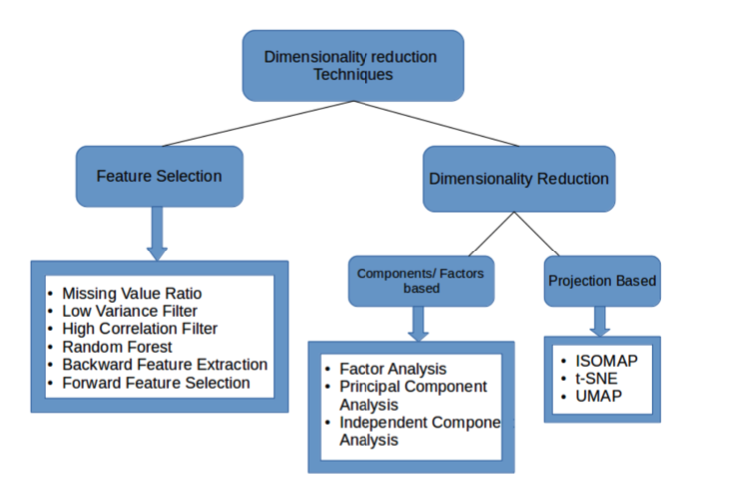
Feature Selection vs Dimensionality Reduction
PCA and LDA were dimensionality reduction techniques
Filter and Wrapper methods are variable selection techniques
Dimensionality reduction: Creates new features that are functions of the original ones (for PCA/LDA, linear combinations of the original ones).
Less information lost
Less interpretability
Feature Selection: Removes redundant features and keeps important ones (no new features created).
More information lost
More interpretability
Notes:
Can be confusing because dimensionality reduction can refer to generally reducing dimensions, or a more specific set of techniques that reduce dimensions. (refer to image).
Dimensionality reduction is more “sophisticated”

Slide 26
Feature Selection vs Dimensionality Reduction
height (h) | weight (w)
170 | 80
175 | 81
161 | 71
182 | 83
164 | 76
165 | 76
185 | 90
???

Slide 27
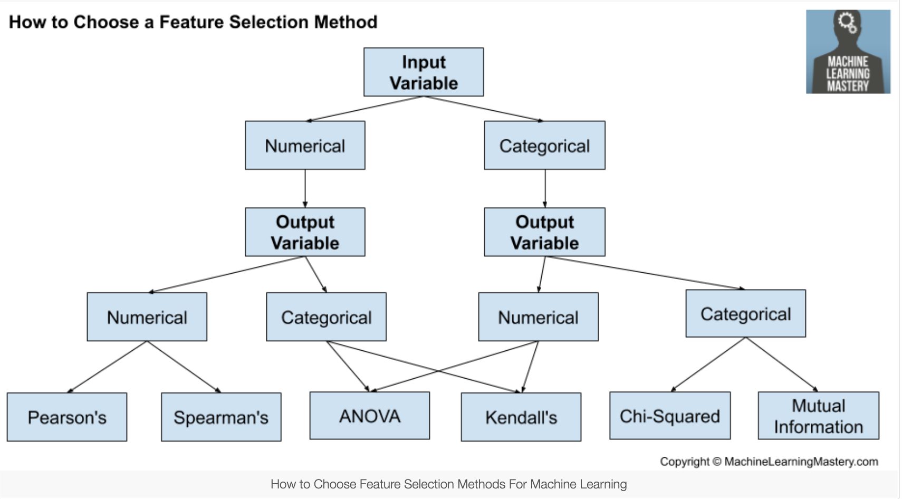
Filter Methods
Give each feature a “score” that represents how “important” it is.
Scores can be based on:
Correlation with target variable
High/low variance
Feature similarity (correlation between features)
Keep features with high scores, discard features with low scores.
Applied before training ML model
Advantages:
Fast—no training involved, just calculations
Disadvantages:
Can ignore feature combinations
May keep redundant features
Notes:
Correlation with target variable is most common. Correlation calculation specifics depends on type of data (numerical vs categorical)

Slide 28
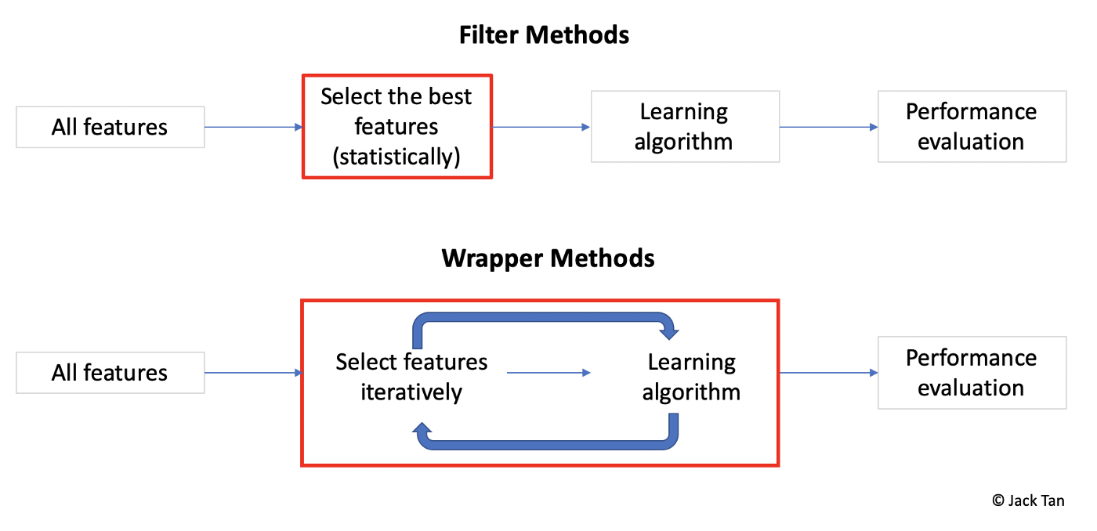
Wrapper Methods
Train model multiple times with different combinations of subsets of features.
Goal is to find the “best” subset of features.
Advantages:
Evaluates features in context of others
Performance-driven
Disadvantages:
Slow (must re-train model each time)
Popular wrapper methods:
Forward selection
Backward selection
Stepwise selection
Notes:
Compare wrapper vs filter methods

Slide 29
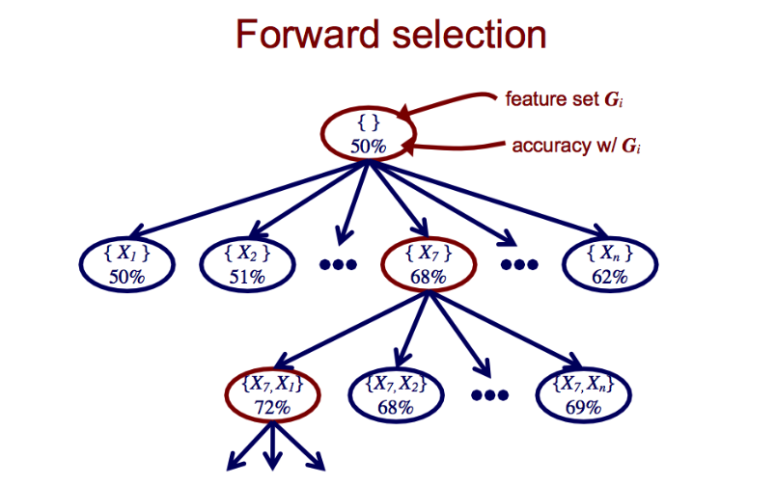
Wrapper Methods: Forward Selection
SelectedFeatures = [ ]
Find F in (AllFeatures - SelectedFeatures) that, if added to SelectedFeatures, best improves model performance.
If adding F improved performance more than some threshold, permanently add it to SelectedFeatures and go back to 2.
Efficient for choosing a small subset of features.
Misses features whose usefulness requires other features (feature synergy).

Slide 30
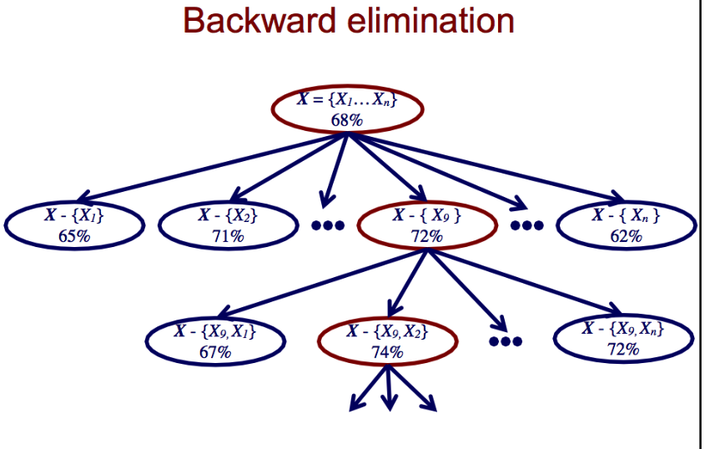
Wrapper Methods: Backward Selection
SelectedFeatures = AllFeatures
Find F in SelectedFeatures that, if removed from SelectedFeatures, best improves model performance (or decreases model performance the least).
If removing F improved (or decreased) performance more (or less) than some threshold, permanently remove it from SelectedFeatures and go back to 2.
Efficient for discarding a small subset of features.
Preserves features whose usefulness requires other features.
Less efficient for computation.
It takes more time to fit models with all features than with one feature.

Slide 31
Wrapper Methods: Stepwise Selection
A combination of Forward and Backward Selection.
SelectedFeatures = [ ]
Perform Forward Selection
Perform Backward Selection
Repeat 2. and 3. until a final optimal set of features is obtained.
Can alternatively start with SelectedFeatures = AllFeatures, or somewhere in between.

Slide 32
Wrapper Methods
Generally, it’s not possible to tell which method will work best until you try.
Different variable selection algorithms may give you different answers.
Different machine learning algorithms with the same variable selection method may give you different answers.
Over this process, you'll find out what features tend to get eliminated and which features tend to be kept (hopefully).

Slide 33
Dimensionality Reduction: Takeaways
Dimensionality reduction: reduce number of features in an optimal way
Minimize information lost and/or maximize model performance.
Dimensionality reduction (PCA and LDA)
Creates NEW variables (dimensions) from the original features using linear combinations
Keep the “best” new variables
Minimizes loss of information
PCA most popular method
PCA unsupervised, LDA supervised (requires categorical target variable)
Feature selection (Filter and wrapper methods)
Choose a subset of features in an optimal way
Filter methods are done before training (score each feature, keep best scores)
Wrapper methods are done by re-training the model with different subsets (forward, backward, stepwise)

Slide 34
Dimensionality Reduction: PCA Demo
PCA “Eigenfaces” demo
Each row represents an image.
Each column represents a pixel’s grayscale value

